Slide 1
Improving Conversational Analytics of a Voice-Based Digital Assistant for Geriatric Care
27.03.2023, Bachelor’s Thesis Kickoff Presentation
Nicolas Klein

Slide 2
Outline
Introduction
  Motivation
  Research Goal & Expected Results
Research Approach
  Research Questions
  Methodology
First Insights and Initial Research Results
  Literature Review
  Log-Data Analysis
Next Steps
  Interviews
  Further Timeline

Slide 3

Motivation
Shortage of staff in the elderly care sector & population increase of elderly people
Potential for conversational agents to provide assistance in the geriatric care sector
  Track vital signs and warn about irregularities / call emergency services if necessary
  Casual, informative and entertaining features
Lack of empirical research in the elderly care sector
→ Support this age group with modern technology in daily tasks
ALPHA-KI Research Project
  Digital health assistant for chronically ill people
  Comes embedded in a smartwatch & a stationary smart speaker
  First Rollout: Q4 2022, currently around 15-20 users
  Built on Google’s NLU platform “Dialogflow"
ALPHA-KI Research Project (https://wwwmatthes.in.tum.de/pages/uysghltybqze/AI-Based-Digital-Health-Assistant-ALPHA-KI)

Slide 4
Research Goal & Expected Results
Conversation Driven Development (CDD)
  Best practice for developing conversational AI assistants
  Repeating and non-linear cycle
  Principle: Listen to your users and how they interact with the system → adapt the system → repeat
Focus of this work: Data Analysis (review log-data, track behavior, ..)
Expected Results
  Structure & visualize log-data to provide an overview
  Build a data analysis prototype for conversational analytics
  Gain insights about the agent's behavior based on the data analysis
  Make informed suggestions for improvements of the agent (→ prepare for the ”Fix” phase)
CDD Cycle
Share
Fix
Review / Annotate
Test & Track Behavior
RASA Docs on CDD (https://rasa.com/docs/rasa/conversation-driven-development/)

Slide 5
Outline
Introduction
  Motivation
  Research Goal & Expected Results
Research Approach
  Research Questions
  Methodology
First Insights and Initial Research Results
  Literature Review
  Log-Data Analysis
Next Steps
  Interviews
  Further Timeline

Slide 6
Research Questions
RQ1
What are current insights from literature into “Conversational Analytics” and “Conversation Driven Development” of digital assistants?
RQ2
How can acquired insights from log-data analysis and interviews with developers and users be helpful to uncover the current strengths and weaknesses of the digital assistant?
RQ3
What are potential feasible improvements of the agent?

Slide 7
Methodology
Literature Review
Log-Data Analysis
Semi-structured Interviews
Finished
In Progress
Upcoming
Data Analysis Prototype Development
Iterative Improvements

Slide 8
Outline
Introduction
  Motivation
  Research Goal & Expected Results
Research Approach
  Research Questions
  Methodology
First Insights and Initial Research Results
  Literature Review
  Log-Data Analysis
Next Steps
  Interviews
  Further Timeline

Slide 9
Literature Review
RQ1
What are current insights from literature into “Conversational Analytics” and “Conversation Driven Development” of digital assistants?
Used Libraries: IEEE Xplore, ACM Digital Library, Scopus
Timespan: 2018 – Q1 2023
Search in: Title, Abstract, Keywords
Full Search String:
  ("Conversation Analytics" OR "Conversation Data" OR "Conversational Data" OR "Conversational Analytics" OR "Dialog Analysis" OR "Conversational Analysis" OR "Conversation Analysis" OR "Conversation Driven Development" OR "Conversational Dataset" OR "Dialogue Analysis" OR "Conversation Exploration") AND ("Chatbot" OR "Conversational Agent" OR "Chat bot" OR "Voicebot" OR "Voice bot" OR "Conversational Interface" OR "Dialog System" OR "Digital Assistant" OR "Virtual Assistant" OR "Conversational Assistant" OR "Voice Assistant" OR "Conversational System")
Initial Selection Criteria: Combination of (conversational) data analysis with a type of digital assistant
Backward Search (Keywords & Papers)
Skimming through papers to ensure relevancy
→ Search resulted in 14 relevant papers

Slide 10
Literature Review
Objectives
  Find common approaches for (log-)data analysis
  Identify core analysis functions & typical metrics
  Explore types of visualizations (diagrams, graphs, …)
Initial Insights
  Fallback response rate & effectiveness / wording of the fallback response
  Rate of (un-)successful conversations
  Types of “Confidence Scores” in [0,1] (acoustic understanding, intent match, answer quality)
  bad responses (fallback to valid request, wrong intent match, correct but unsatisfying response, …)
Limitations
  “Conversation Analysis” often analyzes long conversations → ALPHA-KI agent so far has mostly short conversations (2-5 dialog turns)
  There is no literature on conversational agents in the elderly care sector (has its own specific challenges)
A Conversation-Driven Approach for Chatbot Management (https://ieeexplore.ieee.org/document/9681834)
The Potential of Chatbots: Analysis of Chatbot Conversations (https://ieeexplore.ieee.org/document/8808076)

Slide 11
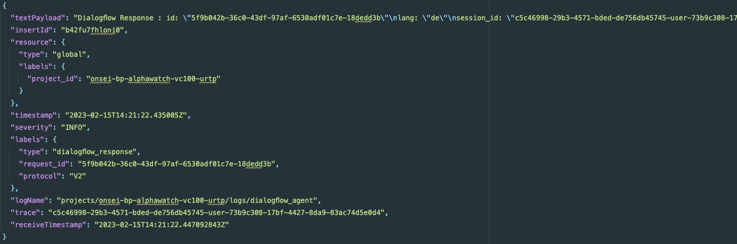
Log-Data Analysis
Since rollout of the agent → Dialogflow log-data has been collected (logs get deleted after 1 month)
Logs are JSON structured
Example Log Entry

Slide 12
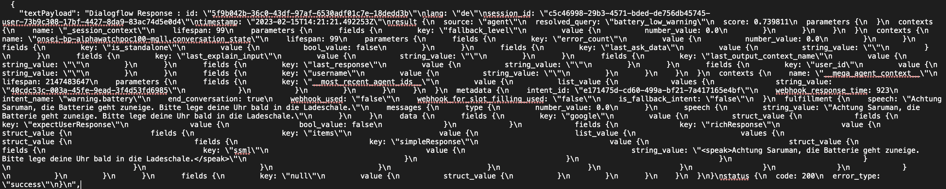
Log-Data Analysis
Example Text-Payload
Text payload contains a lot of relevant information which needs to be extracted
  But: Payload format is not valid JSON → Payload is actually structured in HOCON
Implementation of own parser / usage of an existing parser
  → New & deeply reformatted JSON log files

Slide 13
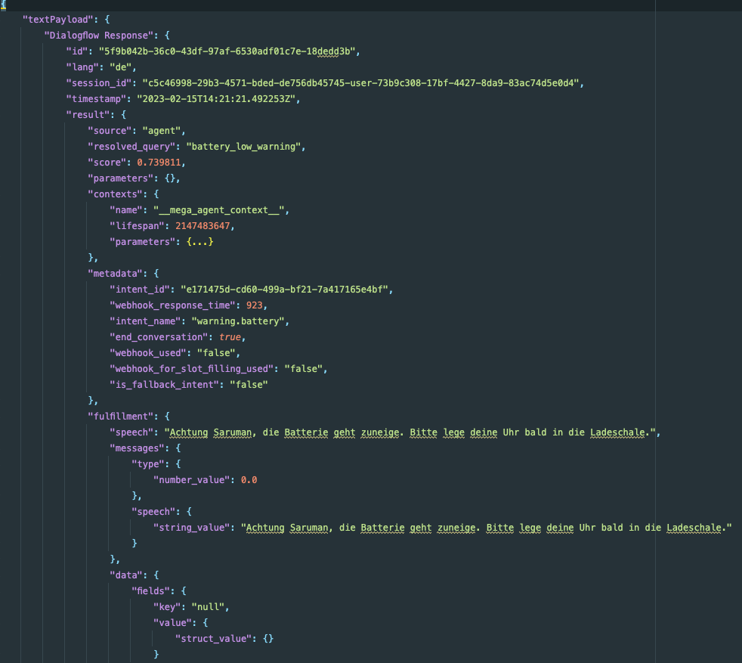
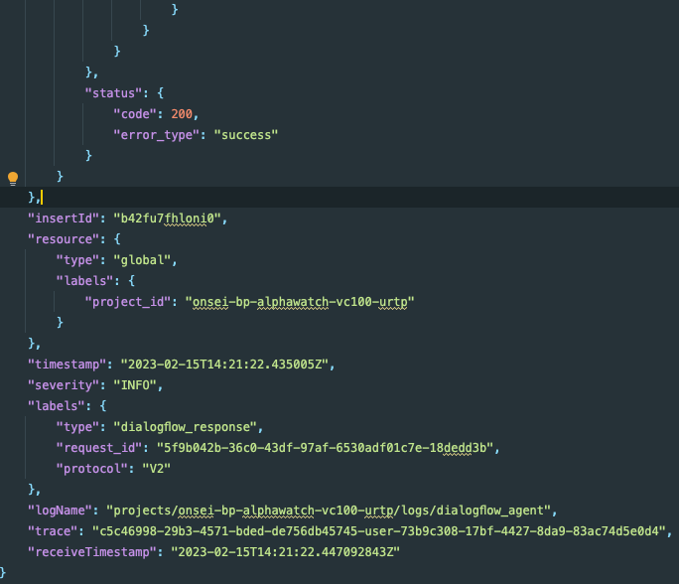
Log-Data Analysis
Restructured JSON Log File

Slide 14
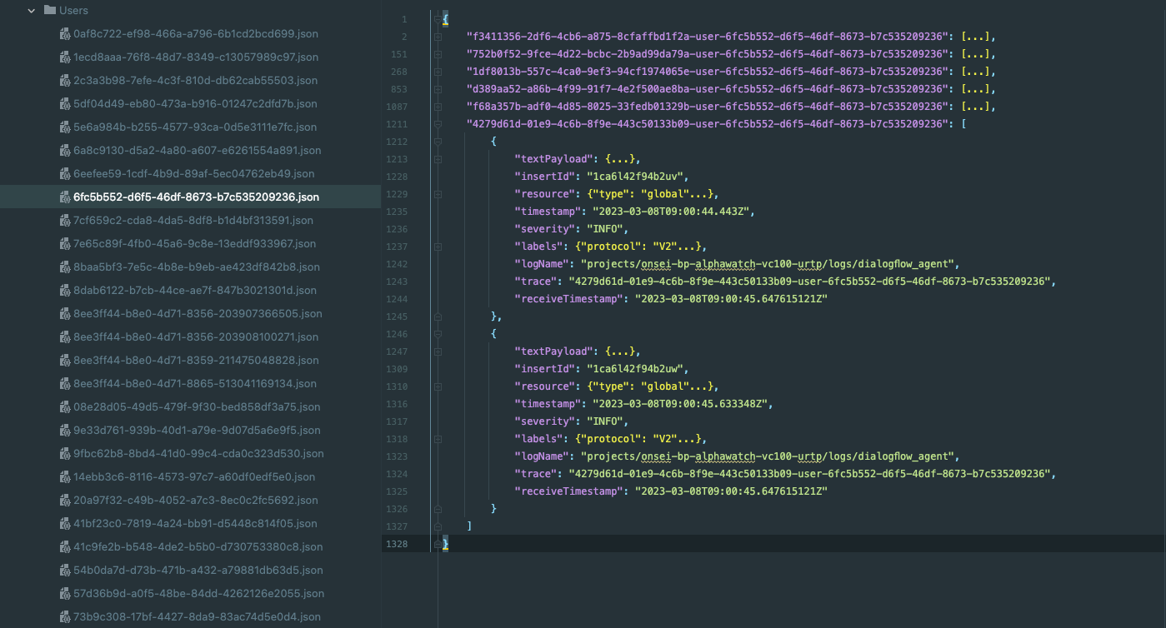
Log-Data Analysis
One Month Log-Data File:
Implemented features
  Text payload parser
  JSON file re-formatter
  Extraction of basic metrics
  Sort data by user-ID &
  session-ID
Total Entries | Unique Intents (most common) | Sessions | Fallback Answers (most common)
10000 | 91 (hydro.tracking.start) | 1537 | 139 (Default Fallback Intent)
Session-ID
log entry
User-ID

Slide 15
Outline
Introduction
  Motivation
  Research Goal & Expected Results
Research Approach
  Research Questions
  Methodology
First Insights and Initial Research Results
  Literature Review
  Log-Data Analysis
Next Steps
  Interviews
  Further Timeline

Slide 16
Interviews
Interviews with domain experts / developers
Interviews with users (if possible)
What challenges do you see when developing a voice assistant specifically for elderly people?
What are relevant metrics for you when analyzing information from log data?
What (de-)motivates you to use the agent?
Does the agent make your daily life easier?
Are you excited to use new technology like this, or is it not interesting / scary for you?
→ Gain insights to iteratively improve & adjust the data analysis process

Slide 17
Timeline
February
March
April
May
June
July
Literature Review
Log-Data Analysis & Evaluation
Plan & Conduct Interviews
Iterative Prototype Development
Thesis Writing
15th of February:
Start of working period
27th of March:
Kickoff Presentation
15th of July:
End of working period

Slide 18
Nicolas Klein
17132
matthes@in.tum.de

